Slide 1

Pune District Education Association's College of Engineering
Hadapsar Rd, Manjari Budruk, Pune,
Maharashtra 412307.
A PROJECT ON
“STUDENT GRIEVANCE”
Submitted By:
-VADKE SAIE [CO-13]
-SABLE PALLAVI [CO-11]
-JANGALE NATASHA [CO-21]
Guided By:
-S. V. PHULARI

Slide 2
Problem Statement of Project
Project profile
Functions to be provided
Diagrams
Functional specificaion
Page desigining
Terms of project
Functional decsription
Relevance
Reference and conclusion

Slide 3
Project Profile
NBJV
Student Grievance System provides services for arrived grievance of students.
Students can also know the status of their complaints.
All the complaints arrived from students are seen by the teacher and valid complaints are solved by teacher and status of replied complaints is changed to success.
Admin can see all the Grievance and access to add members is given to admin.

Slide 4
Functions To Be Provided
The current complaint box system is manual as all the work is done and kept in the form of paper.
As existing system needs to manually solve the complaints.
All the necessary information is in the form of hard copy.
So it became much difficult for staffs to keep the records and understand the complaints from the specific students .
Using this system students can directly upload their complaints.
Teacher can response immediately to the complaints

Slide 5
Objectives of project
Improved services for the students and teachers/staff.
Reduce use of papers.
From the proposed system we can save a lot of time is a major factor.
The login and password page also secures your system property
The college can easily understand the complaints of the Students

Slide 6
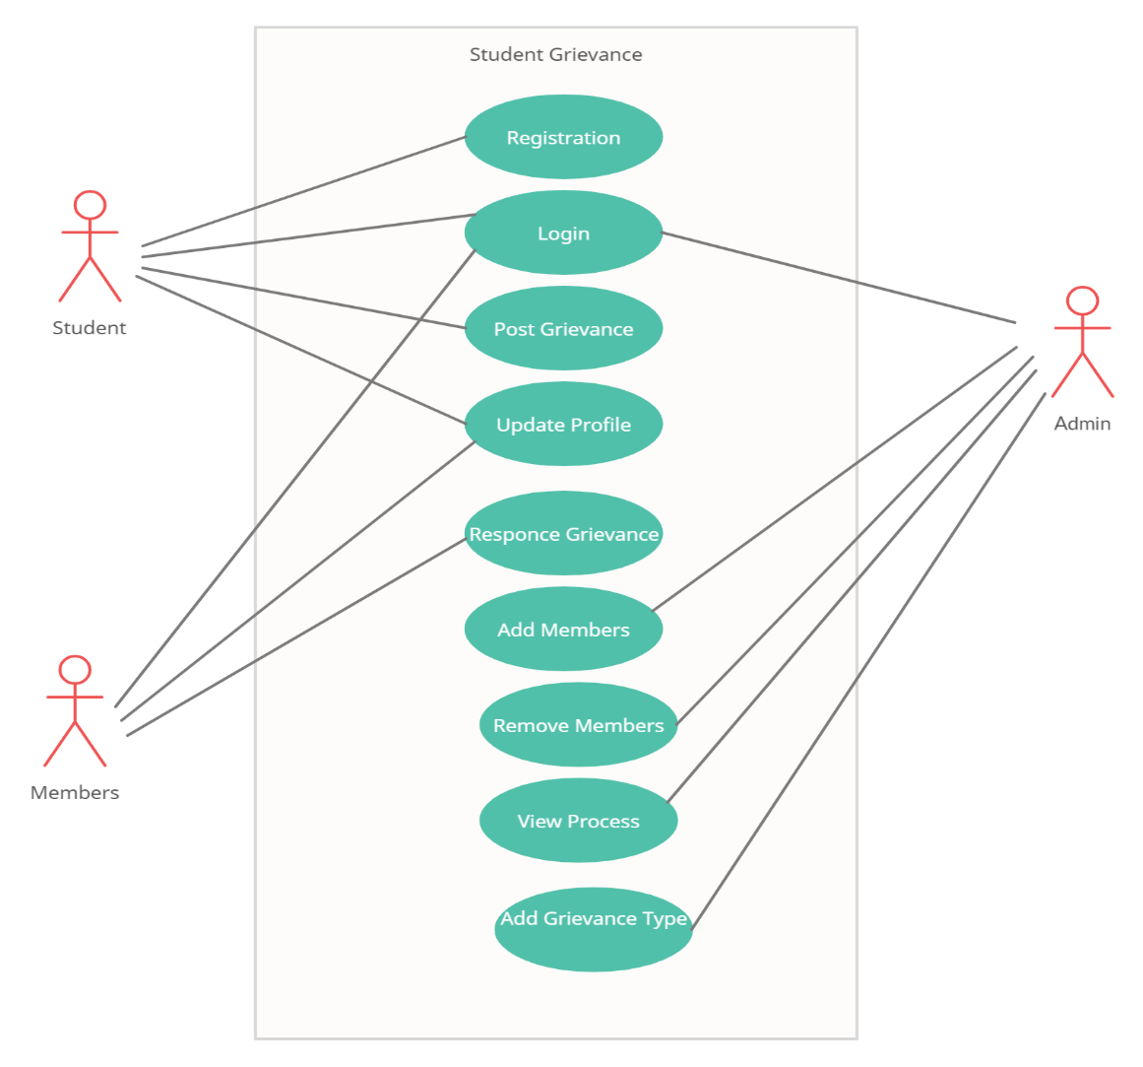
Use case diagram
Use Case Diagram

Slide 7
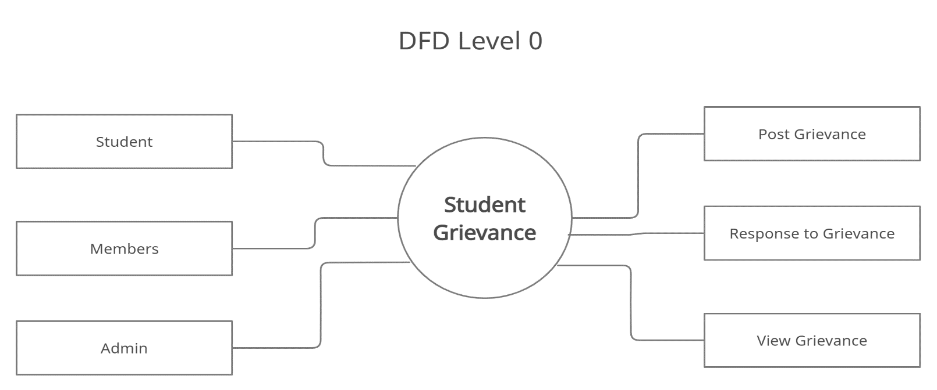
Data flow diagram

Slide 8
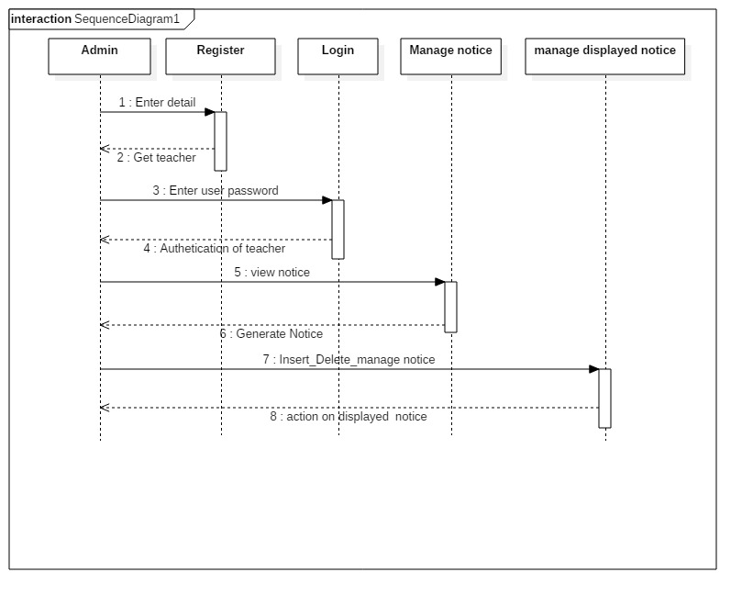
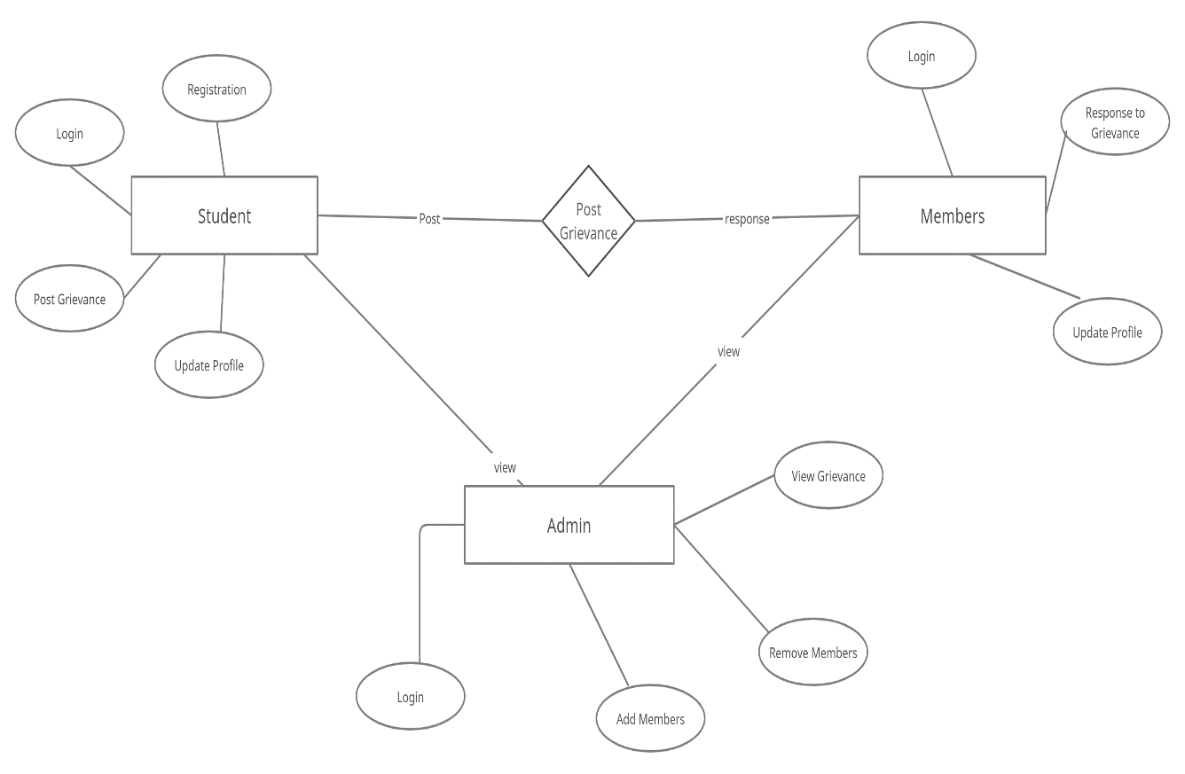
Sequence Diagram
ER Diagram

Slide 9
Functional specification of project
Hardware Specification:
Processor : Intel i5
RAM : 3 GB
Hard Disk : 50GB
Software Specification:
Sublime Text 3
Apache Tomcat , Wamp server
Oracle
Platform Specification:
Operating System : Windows 10
Front End : JSP, HTML, PHP
Back End : MySQL

Slide 10
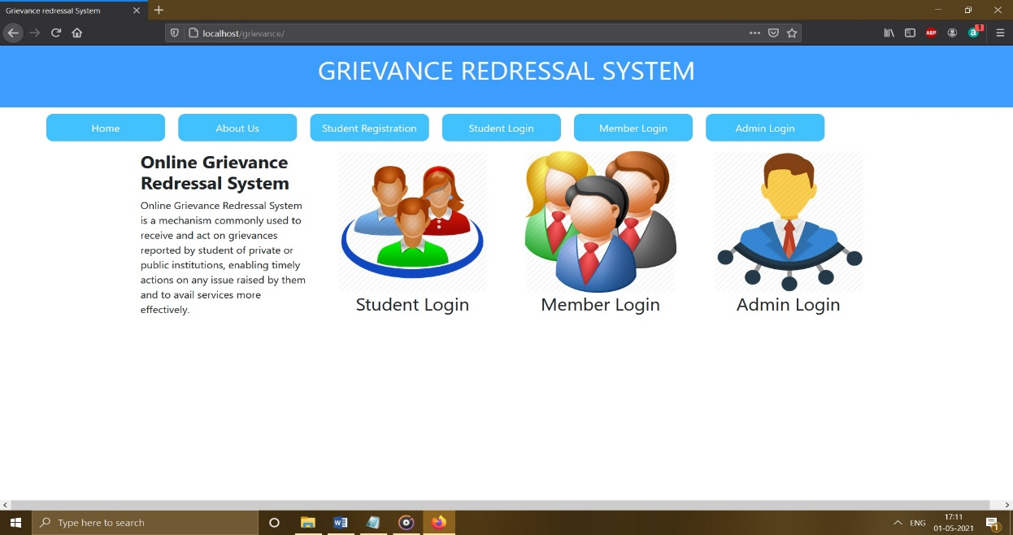
HJTFY
Homepage:

Slide 11
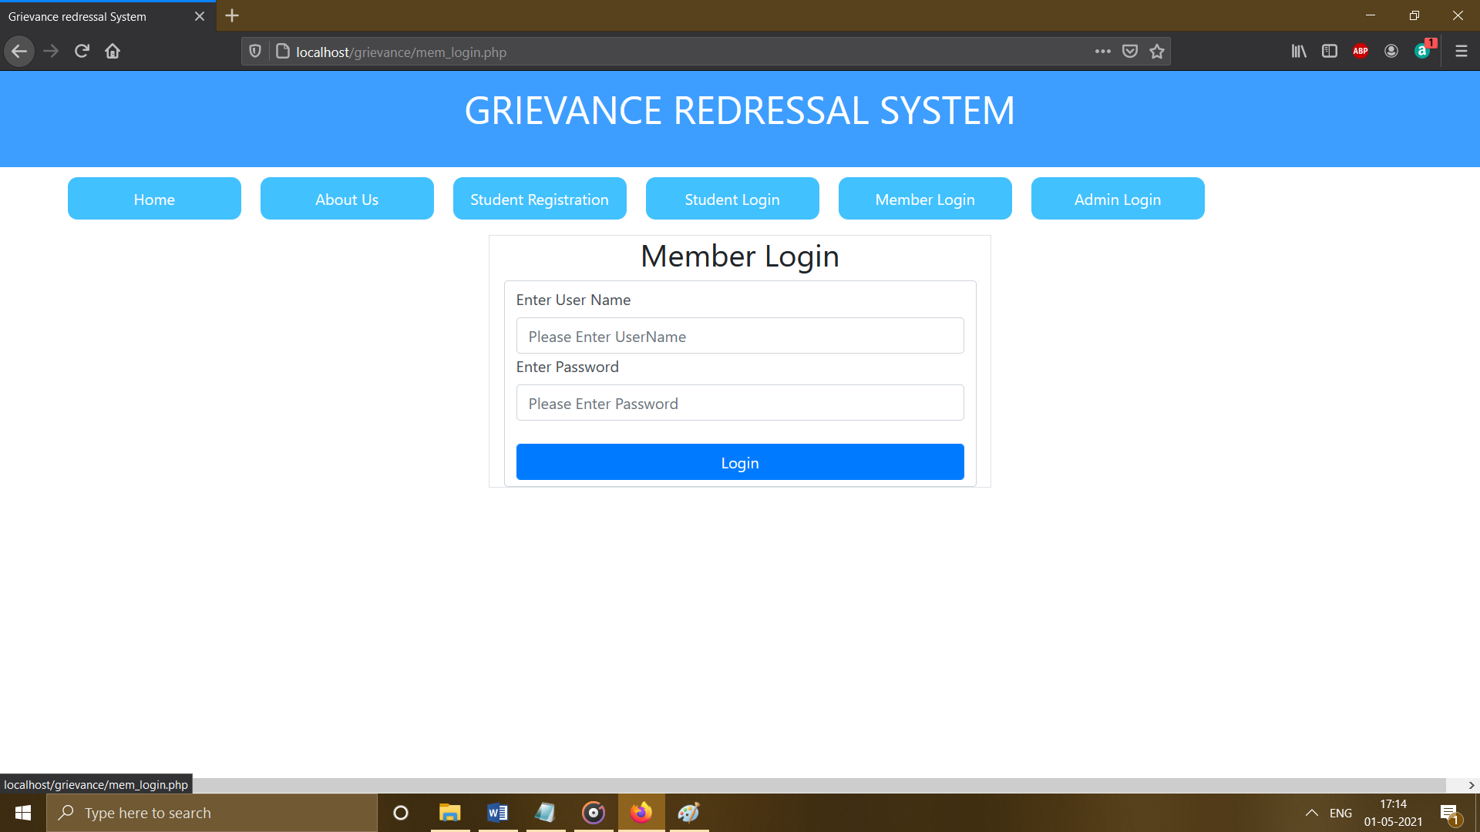
Member Login:

Slide 12
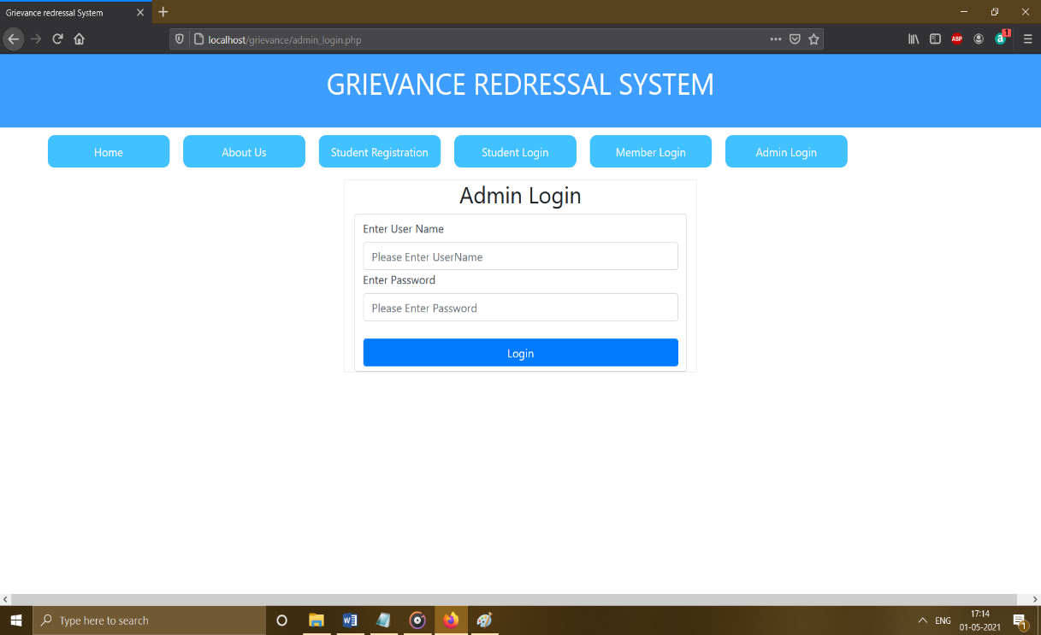
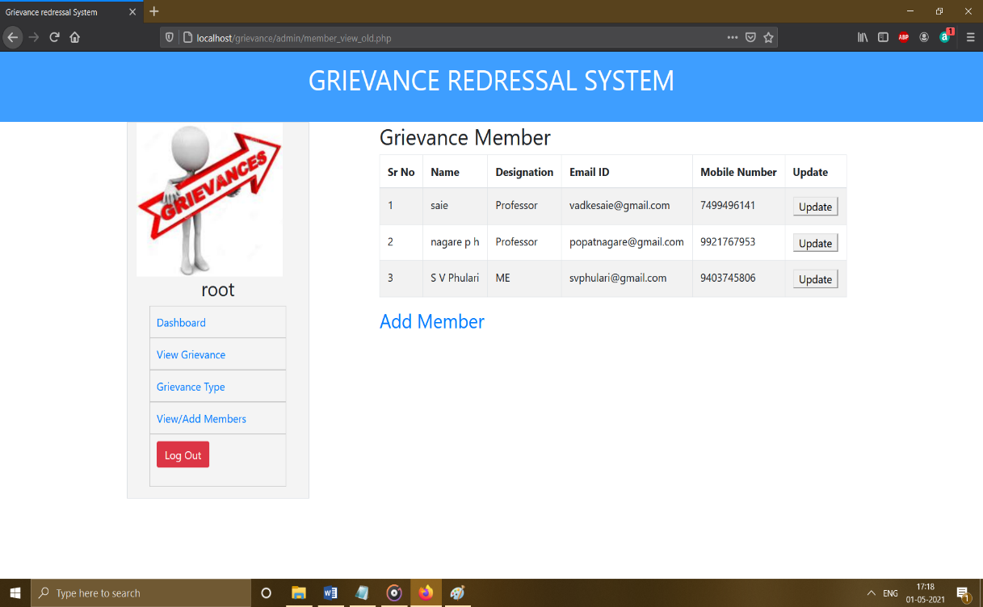
login p
Admin Logic:
Add Members:

Slide 13
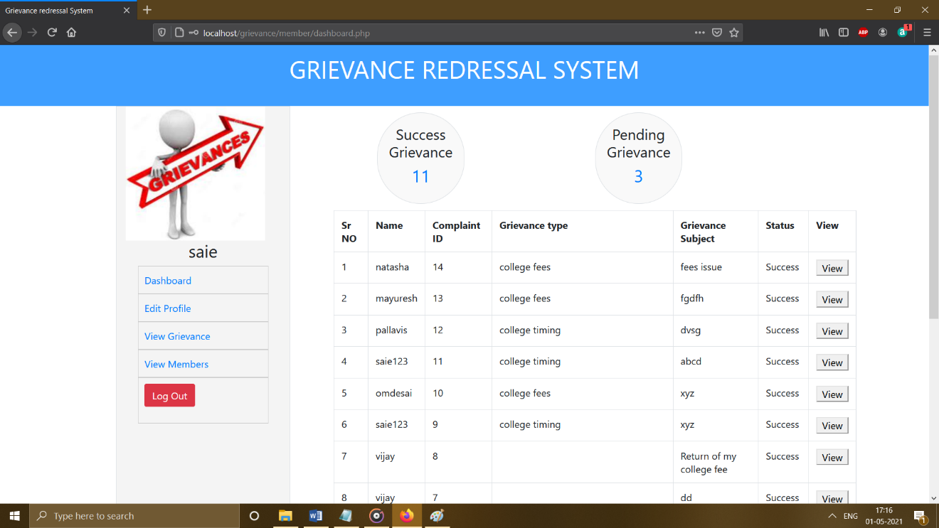
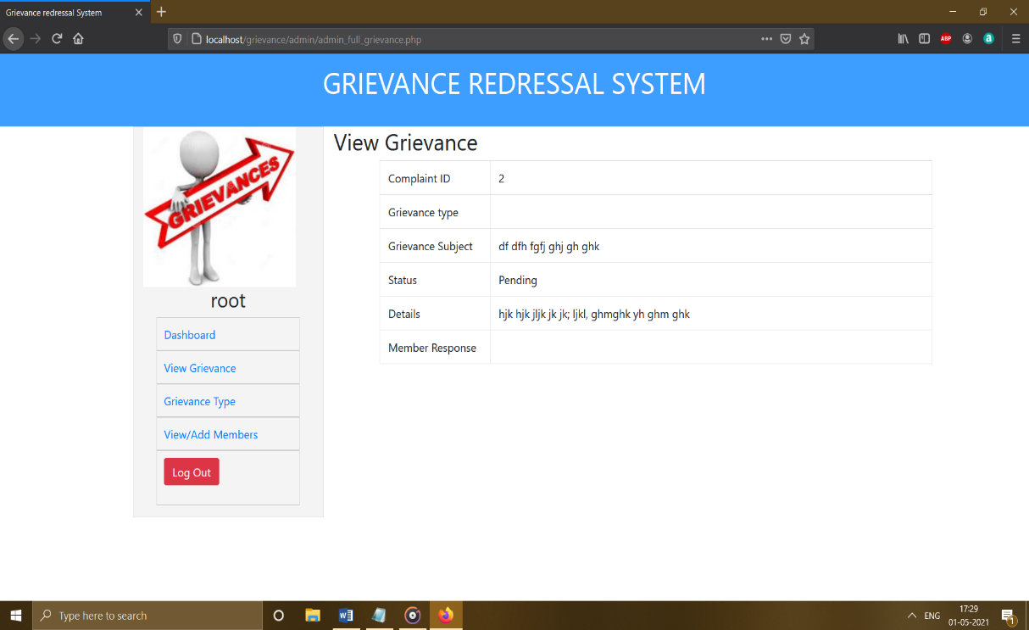
Grievance Status:
View Grievance:

Slide 14
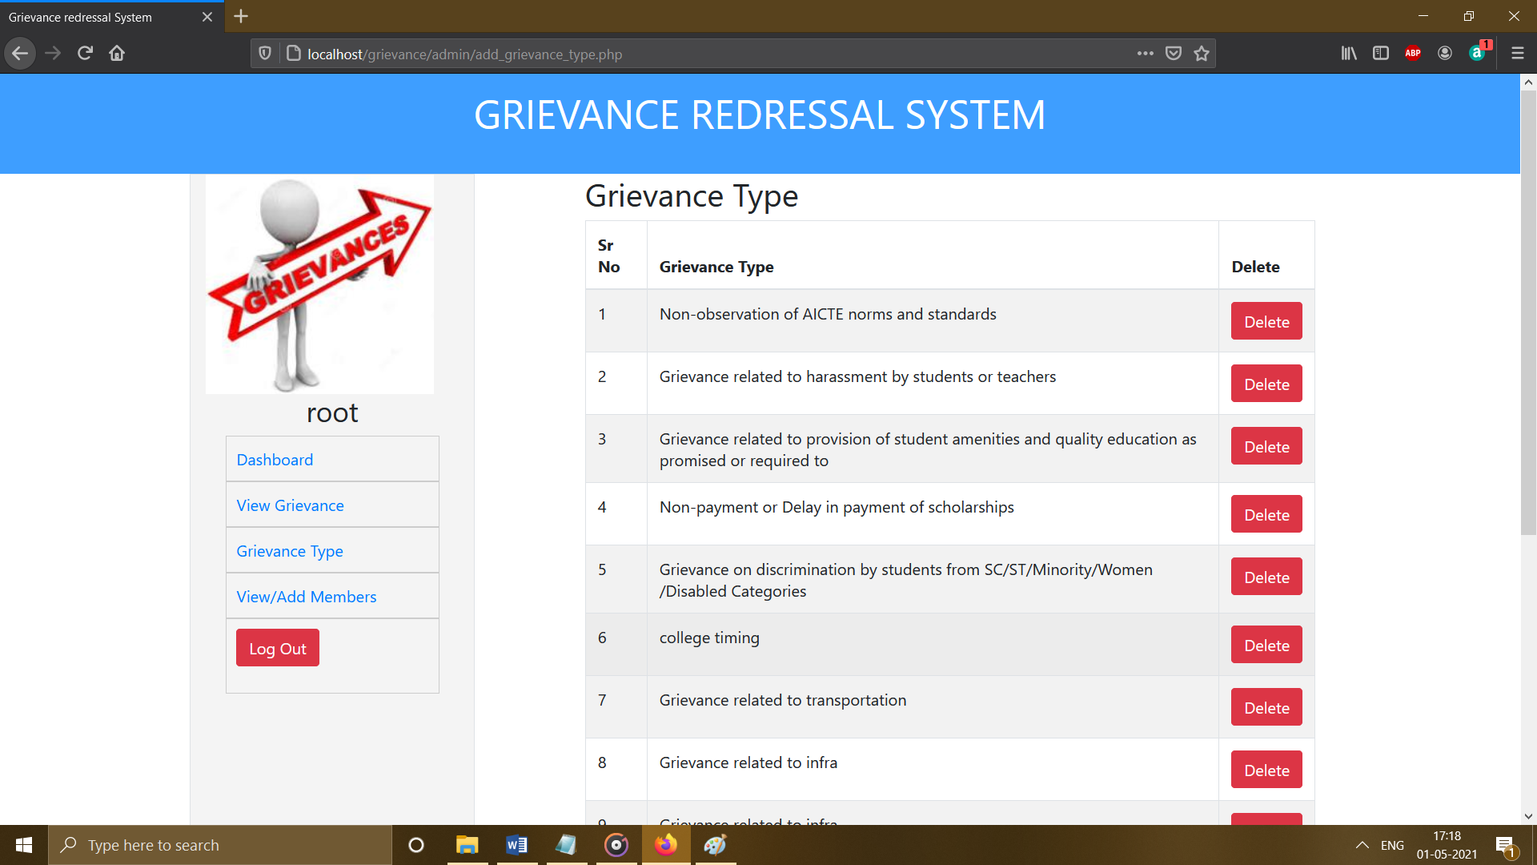
Add Grievance:

Slide 15
Terms of Project
It includes terms like admin, teachers and students
Admin: Admin is the person who controls monitors and keeps the whole flow of the system.
Students: Students are those who add their complaints in system
Teacher: Teacher are the person who understands the students complaints and gives the solution.

Slide 16
Relevance
Grievance system provides solution by offering ability to share information about complaints between teacher and students.
It act as a mediator between teacher and students. Admin can add members, grievance information and students can check the status.
It saves time and wastage of paper. Our main focus is to provide the efficiency and systematically provide solution to grievance.

Slide 17
Reference and conclusion
https://w3layouts.com/electronics
https://www.w3schools.com/w3css/w3css_slideshow.asp
https://www.w3schools.com/howto/howto_css_register_form.asp
https://www.w3schools.com/howto/howto_css_checkout_form.asp
https://google.com

Slide 18
Conclusion:
The project was developed successfully by the valuable guidance and support of team members
The system can be designed for further enhancement. This could also be developed according to the growing needs of the students.
THANK YOU…

